Slide 1
Modern Full Stack ECommerce Application with Stripe & Xano
Building and Deploying a Fully Responsive ECommerce Solution

Slide 2
Project Overview
project's key features and objectives.
technologies used, such as HTML, CSS, JavaScript, jQuery, Xano, and Stripe.

Slide 3
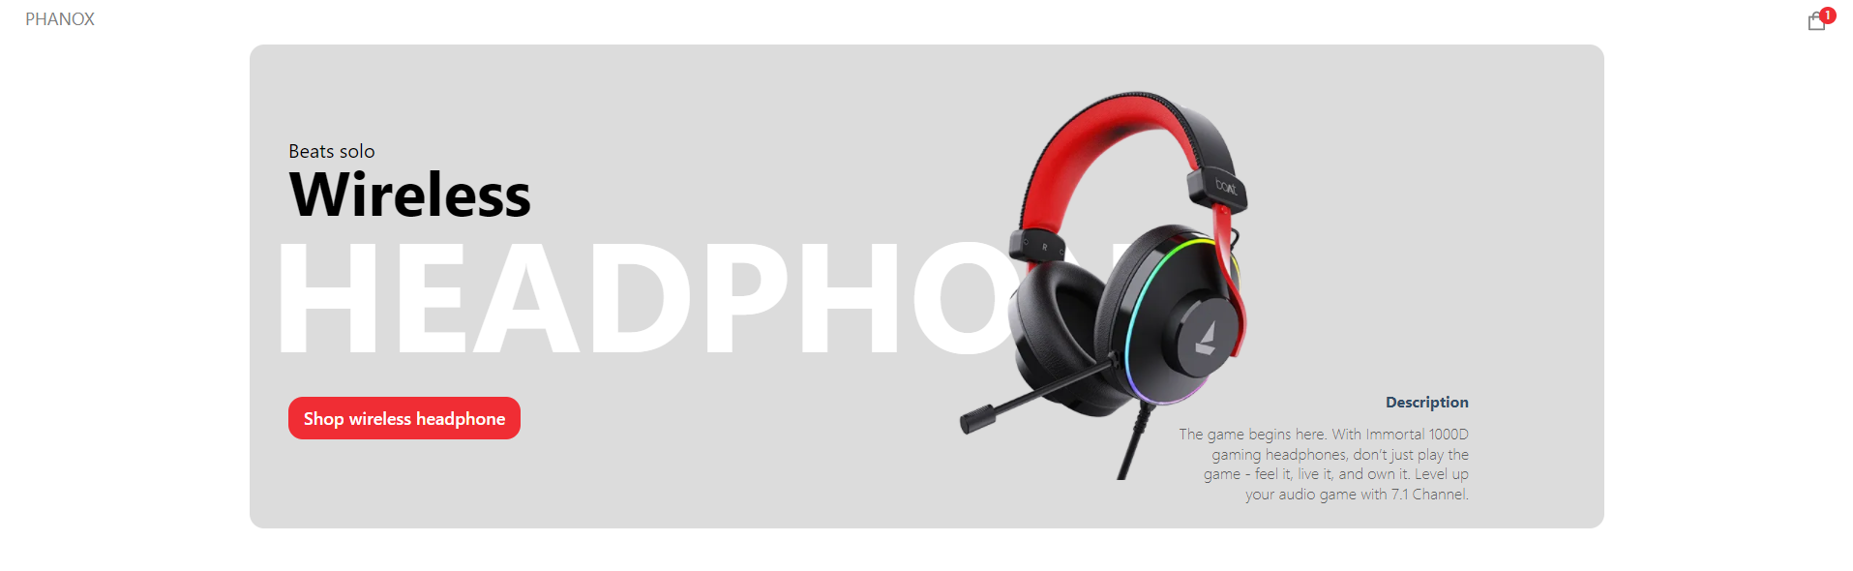
Project Screenshots

Slide 4


Slide 5


Slide 6


Slide 7
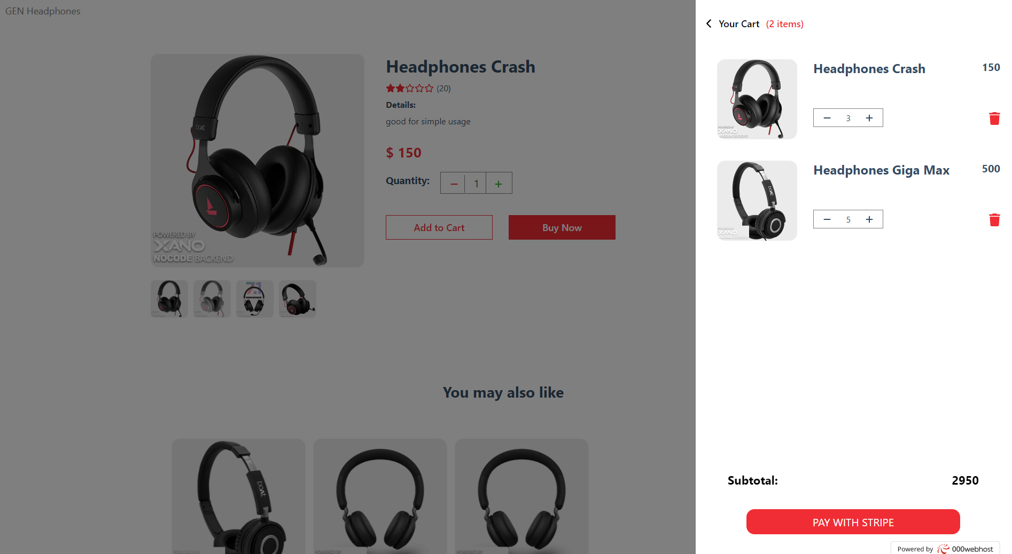

Slide 8
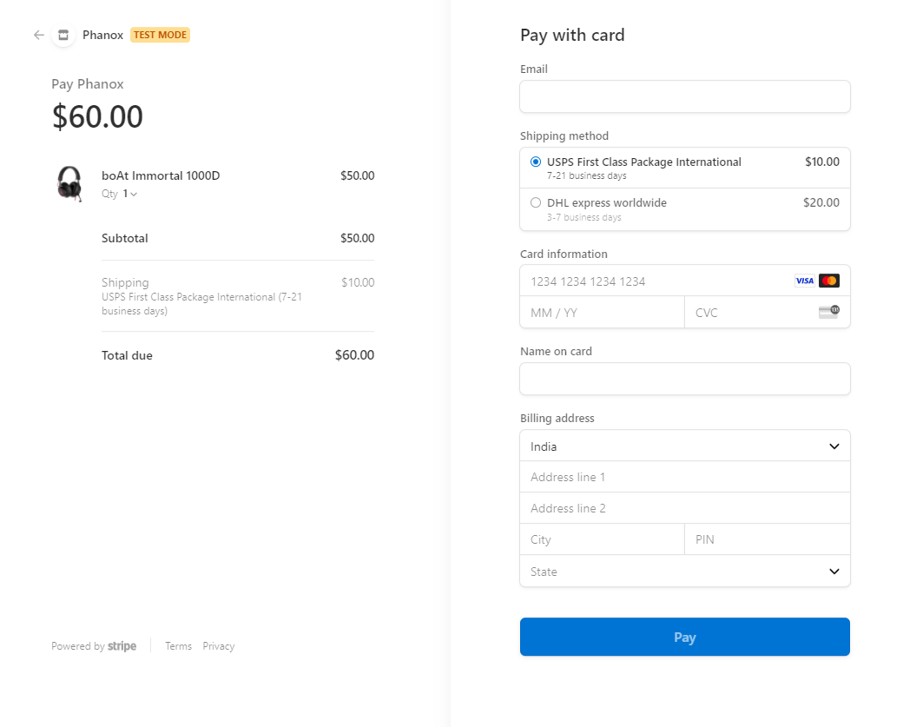

Slide 9


Slide 10
Content Management System (CMS)
Explain the CMS functionality that allows for adding and editing products.
Emphasize the convenience and flexibility this provides.

Slide 11
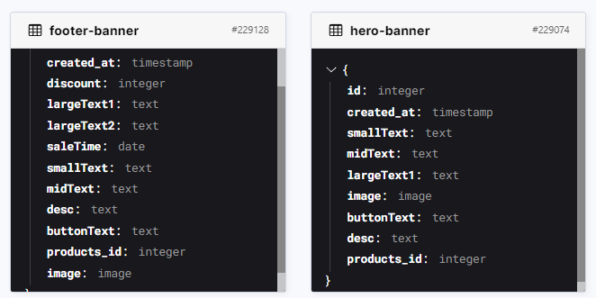
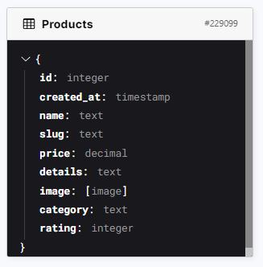
Xano Database
Footer Banner Manage
Hero Banner Manage
Product Manage

Slide 12
Xano API – Home Page
Hero banner details
Footer banner details
Get All Products

Slide 13
Xano API – Product Page
Product details
Related Products
Add To Cart

Slide 14
Xano API – Cart Page
Cart details
Total Price
Delete Cart Item
Change Cart Item Quantity

Slide 15
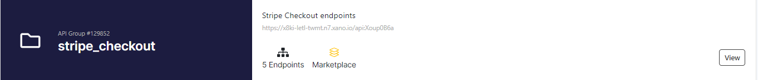
Stripe Integration
Xano Extension Stripe Checkout
Stripe Checkout API
Stripe Checkout Session
Reset Cart

Slide 16
Real Payments
Payment
Products
Developers

Slide 17









Technologies Used

Slide 18
Production & Development Details
Development
Production
Third Part

Slide 19

Challenges and Solutions
Xano Free Plan Supports 10 requests per second and this slow dealing with website.
Xano Logo on any image
Solution
- Free Plan good for testing not for production.

Slide 20
Future Enhancements
Multi Seller
Inventory Management
Authentication
Authorization
Admin Dashboard

Slide 21



Contact Information
https://www.linkedin.com/in/solieman-snossy/
soliemansnossy@gmail.com
solieman@gensystem.net

Slide 22
Thank You

